Slide 1
Chapter 2
The Chemical Context of Life

Slide 2
Overview: A Chemical Connection to Biology
Biology is a multidisciplinary science
Living organisms are subject to basic laws of physics and chemistry
One example is the use of formic acid by ants to maintain “devil’s gardens,” stands of Duroia trees
Copyright © 2008 Pearson Education, Inc., publishing as Benjamin Cummings

Slide 3
Fig. 2-1
Notes:
Figure 2.1 Who tends this garden?

Slide 4
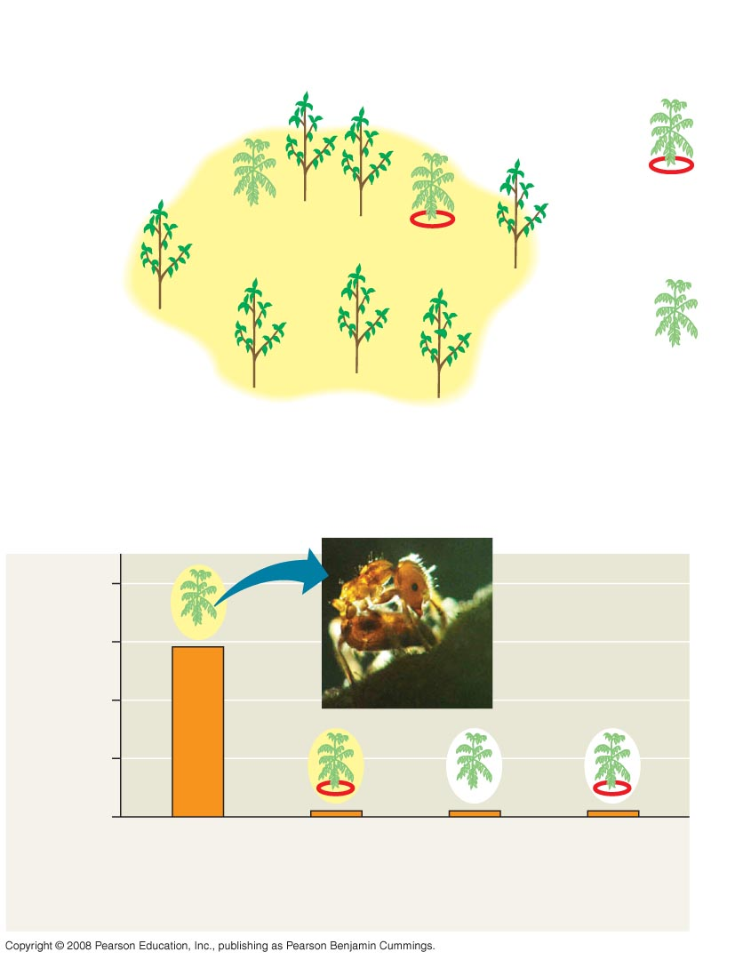
Fig. 2-2
EXPERIMENT
Cedrela
sapling
Insect
barrier
Duroia
tree
Outside,
protected
Inside,
unprotected
Inside,
protected
Devil’s
garden
Outside,
unprotected
RESULTS
16
12
Dead leaf tissue (cm²)
after one day
8
4
0
Inside,
unprotected
Inside,
protected
Outside,
unprotected
Outside,
protected
Cedrela saplings, inside and outside devil’s gardens
Notes:
Figure 2.2 What creates “devil’s gardens” in the rain forest?

Slide 5
Concept 2.1: Matter consists of chemical elements in pure form and in combinations called compounds
Organisms are composed of matter
Matter is anything that takes up space and has mass
Copyright © 2008 Pearson Education, Inc., publishing as Benjamin Cummings

Slide 6
Elements and Compounds
Matter is made up of elements
An element is a substance that cannot be broken down to other substances by chemical reactions
A compound is a substance consisting of two or more elements in a fixed ratio
A compound has characteristics different from those of its elements
Copyright © 2008 Pearson Education, Inc., publishing as Benjamin Cummings

Slide 7
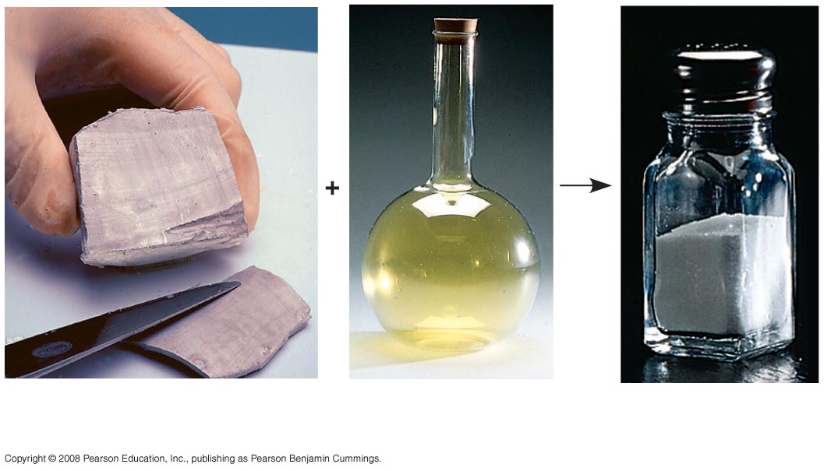
Fig. 2-3
Sodium
Chlorine
Sodium
chloride
Notes:
Figure 2.3 The emergent properties of a compound

Slide 8
Essential Elements of Life
About 25 of the 92 elements are essential to life
Carbon, hydrogen, oxygen, and nitrogen make up 96% of living matter
Most of the remaining 4% consists of calcium, phosphorus, potassium, and sulfur
Trace elements are those required by an organism in minute quantities
Copyright © 2008 Pearson Education, Inc., publishing as Benjamin Cummings

Slide 9
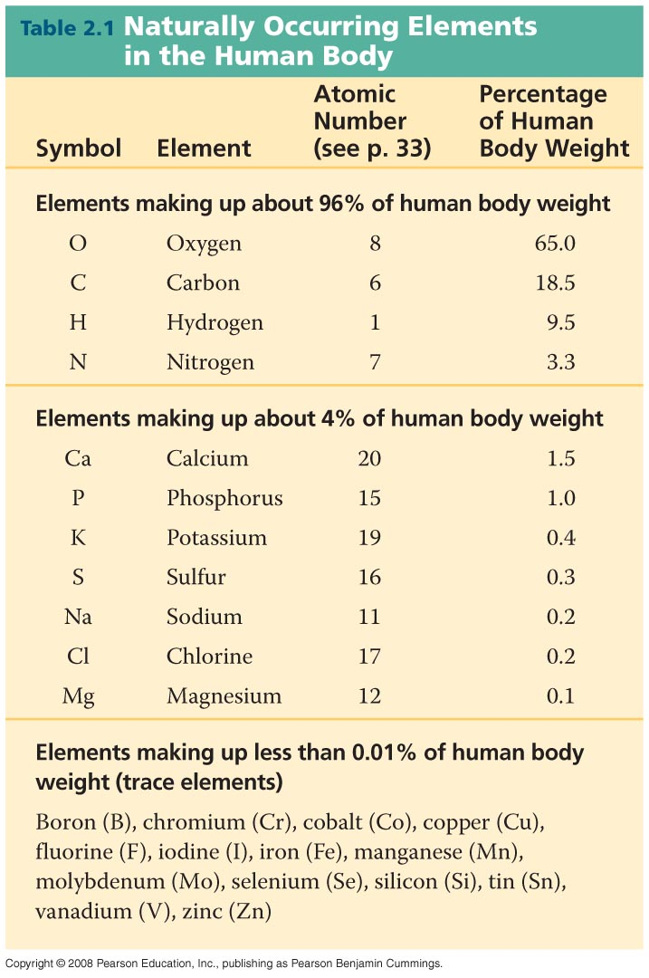
Table 2-1
Notes:
Table 2-1

Slide 10
Fig. 2-4
(a) Nitrogen deficiency
(b) Iodine deficiency
Notes:
Figure 2.4 The effects of essential-element deficiencies

Slide 11
Concept 2.2: An element’s properties depend on the structure of its atoms
Each element consists of unique atoms
An atom is the smallest unit of matter that still retains the properties of an element
Copyright © 2008 Pearson Education, Inc., publishing as Benjamin Cummings

Slide 12
Subatomic Particles
Atoms are composed of subatomic particles
Relevant subatomic particles include:
Neutrons (no electrical charge)
Protons (positive charge)
Electrons (negative charge)
Copyright © 2008 Pearson Education, Inc., publishing as Benjamin Cummings

Slide 13
Neutrons and protons form the atomic nucleus
Electrons form a cloud around the nucleus
Neutron mass and proton mass are almost identical and are measured in daltons
Copyright © 2008 Pearson Education, Inc., publishing as Benjamin Cummings

Slide 14
Fig. 2-5
Cloud of negative
charge (2 electrons)
Electrons
Nucleus
(a)
(b)
Notes:
Figure 2.5 Simplified models of a helium (He) atom

Slide 15
Atomic Number and Atomic Mass
Atoms of the various elements differ in number of subatomic particles
An element’s atomic number is the number of protons in its nucleus
An element’s mass number is the sum of protons plus neutrons in the nucleus
Atomic mass, the atom’s total mass, can be approximated by the mass number
Copyright © 2008 Pearson Education, Inc., publishing as Benjamin Cummings

Slide 16
Isotopes
All atoms of an element have the same number of protons but may differ in number of neutrons
Isotopes are two atoms of an element that differ in number of neutrons
Radioactive isotopes decay spontaneously, giving off particles and energy
Copyright © 2008 Pearson Education, Inc., publishing as Benjamin Cummings

Slide 17
Some applications of radioactive isotopes in biological research are:
Dating fossils
Tracing atoms through metabolic processes
Diagnosing medical disorders
Copyright © 2008 Pearson Education, Inc., publishing as Benjamin Cummings

Slide 18
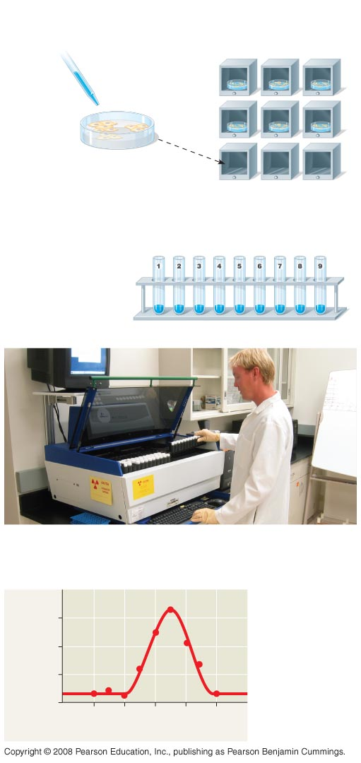
Fig. 2-6
TECHNIQUE
Compounds including
radioactive tracer
(bright blue)
Incubators
1
2
3
10°C
15°C
20°C
Human cells
4
5
6
25°C
30°C
35°C
1
Human
cells are
incubated
with compounds used to
make DNA. One compound is
labeled with ³H.
7
8
9
40°C
45°C
50°C
2
The cells are
placed in test
tubes; their DNA is
isolated; and
unused labeled
compounds are
removed.
DNA (old and new)
3
The test tubes are placed in a scintillation counter.
RESULTS
30
Optimum
temperature
for DNA
synthesis
Counts per minute
(× 1,000)
20
10
0
10
20
30
40
50
Temperature (ºC)
Notes:
Figure 2.6 Radioactive tracers

Slide 19
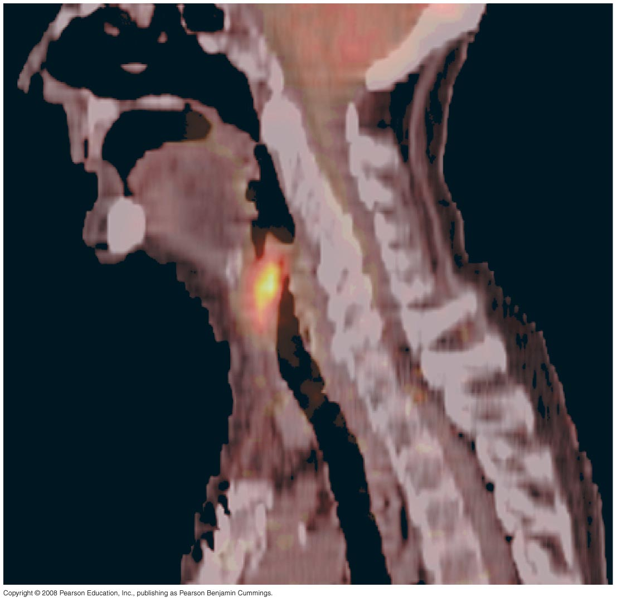
Fig. 2-7
Cancerous
throat
tissue
Notes:
Figure 2.7 A PET scan, a medical use for radioactive isotopes

Slide 20
The Energy Levels of Electrons
Energy is the capacity to cause change
Potential energy is the energy that matter has because of its location or structure
The electrons of an atom differ in their amounts of potential energy
An electron’s state of potential energy is called its energy level, or electron shell
Copyright © 2008 Pearson Education, Inc., publishing as Benjamin Cummings

Slide 21
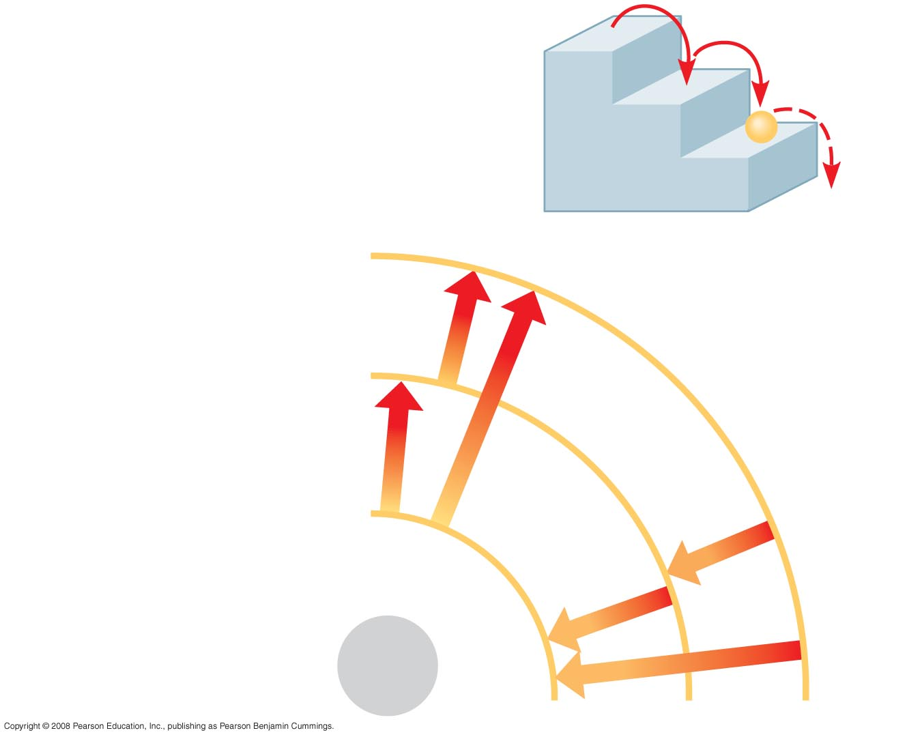
Fig. 2-8
(a) A ball bouncing down a flight
of stairs provides an analogy
for energy levels of electrons
Third shell (highest energy
level)
Second shell (higher
energy level)
Energy
absorbed
First shell (lowest energy
level)
Energy
lost
Atomic
nucleus
(b)
Notes:
Figure 2.8 Energy levels of an atom’s electrons

Slide 22
Electron Distribution and Chemical Properties
The chemical behavior of an atom is determined by the distribution of electrons in electron shells
The periodic table of the elements shows the electron distribution for each element
Copyright © 2008 Pearson Education, Inc., publishing as Benjamin Cummings

Slide 23
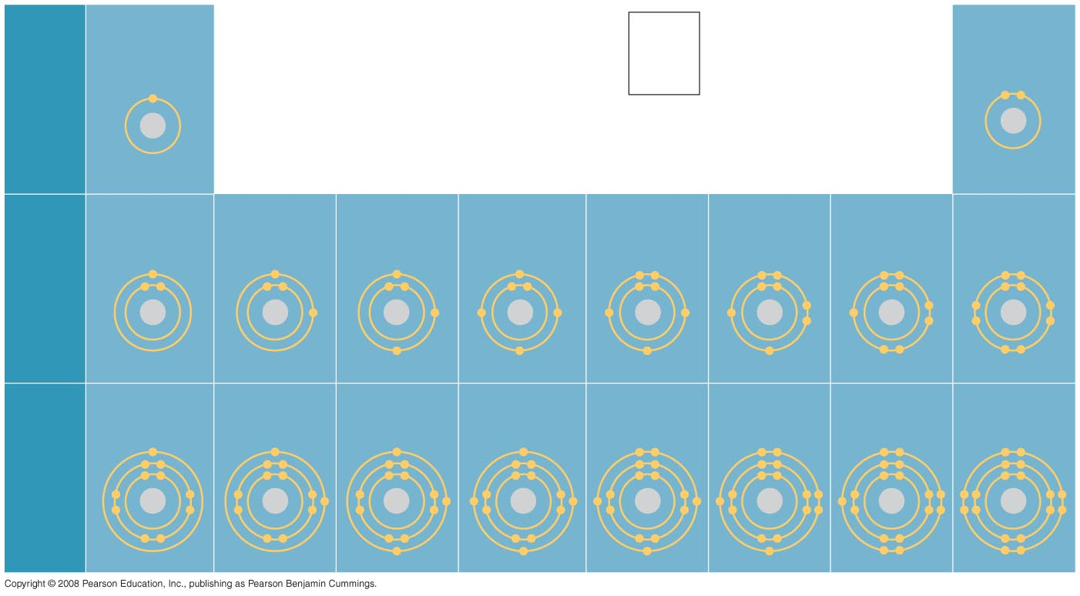
Fig. 2-9
Hydrogen
1H
2
Atomic number
Helium
2He
He
First
shell
Atomic mass
4.00
Element symbol
Electron-
distribution
diagram
Lithium
3Li
Beryllium
4Be
Boron
5B
Carbon
6C
Nitrogen
7N
Oxygen
8O
Fluorine
9F
Neon
10Ne
Second
shell
Sodium
11Na
Magnesium
12Mg
Aluminum
13Al
Silicon
14Si
Phosphorus
15P
Sulfur
16S
Chlorine
17Cl
Argon
18Ar
Third
shell
Notes:
Figure 2.9 Electron-distribution diagrams for the first 18 elements in the periodic table

Slide 24
Valence electrons are those in the outermost shell, or valence shell
The chemical behavior of an atom is mostly determined by the valence electrons
Elements with a full valence shell are chemically inert
Copyright © 2008 Pearson Education, Inc., publishing as Benjamin Cummings

Slide 25
Electron Orbitals
An orbital is the three-dimensional space where an electron is found 90% of the time
Each electron shell consists of a specific number of orbitals
Copyright © 2008 Pearson Education, Inc., publishing as Benjamin Cummings

Slide 26
Fig. 2-10-4
Neon, with two filled shells (10 electrons)
(a)
Electron-distribution
diagram
First shell
Second shell
(b)
Separate electron
orbitals
x
y
z
1s orbital
2s orbital
Three 2p orbitals
(c)
Superimposed electron
orbitals
1s, 2s, and 2p orbitals
Notes:
Figure 2.10 Electron orbitals

Slide 27
Concept 2.3: The formation and function of molecules depend on chemical bonding between atoms
Atoms with incomplete valence shells can share or transfer valence electrons with certain other atoms
These interactions usually result in atoms staying close together, held by attractions called chemical bonds
Copyright © 2008 Pearson Education, Inc., publishing as Benjamin Cummings

Slide 28
Covalent Bonds
A covalent bond is the sharing of a pair of valence electrons by two atoms
In a covalent bond, the shared electrons count as part of each atom’s valence shell
Copyright © 2008 Pearson Education, Inc., publishing as Benjamin Cummings

Slide 29
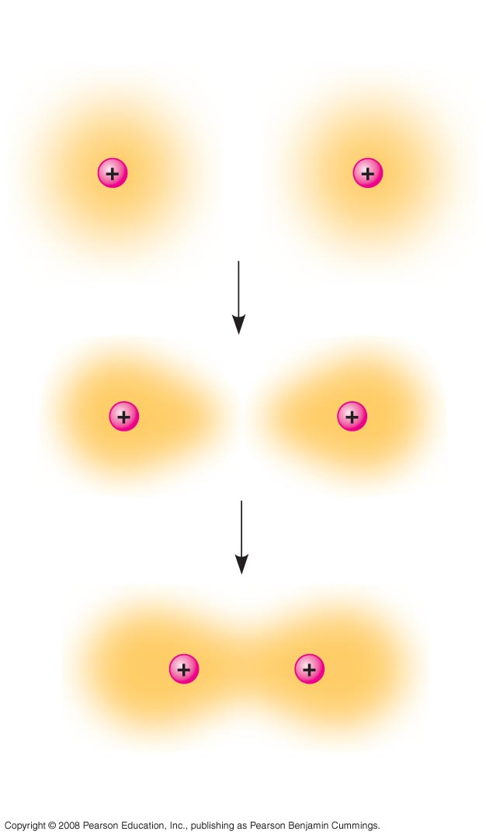
Fig. 2-11
Hydrogen
atoms (2 H)
Hydrogen
molecule (H₂)
Notes:
Figure 2.11 Formation of a covalent bond

Slide 30
A molecule consists of two or more atoms held together by covalent bonds
A single covalent bond, or single bond, is the sharing of one pair of valence electrons
A double covalent bond, or double bond, is the sharing of two pairs of valence electrons
Copyright © 2008 Pearson Education, Inc., publishing as Benjamin Cummings

Slide 31
The notation used to represent atoms and bonding is called a structural formula
For example, H–H
This can be abbreviated further with a molecular formula
For example, H₂
Animation: Covalent Bonds
Copyright © 2008 Pearson Education, Inc., publishing as Benjamin Cummings

Slide 32
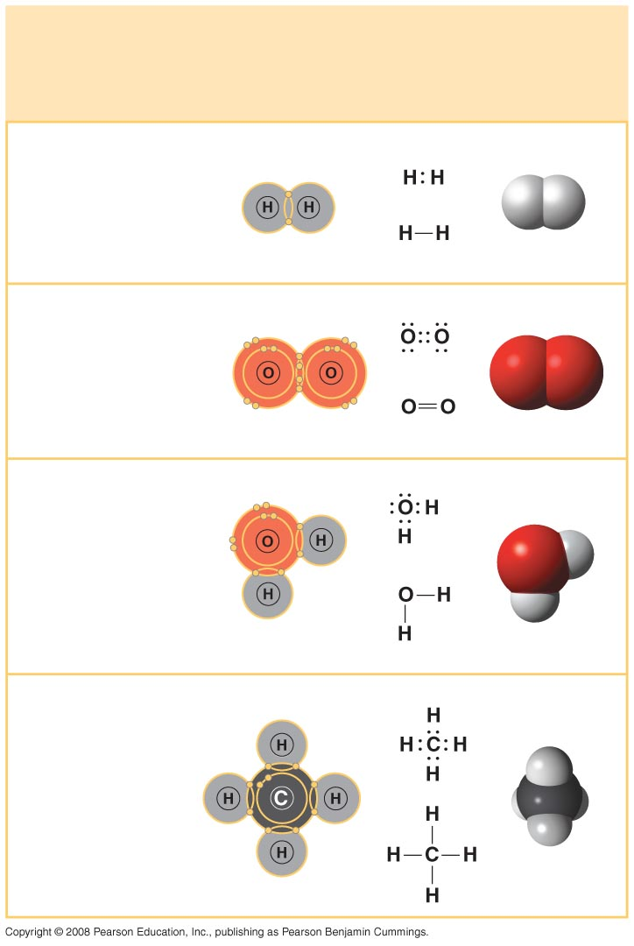
Fig. 2-12
Name and
Molecular
Formula
Electron-
distribution
Diagram
Lewis Dot
Structure and
Structural
Formula
Space-
filling
Model
(a) Hydrogen (H₂)
(b) Oxygen (O₂)
(c) Water (H₂O)
(d) Methane (CH₄)
Notes:
Figure 2.12 Covalent bonding in four molecules

Slide 33
Covalent bonds can form between atoms of the same element or atoms of different elements
A compound is a combination of two or more different elements
Bonding capacity is called the atom’s valence
Copyright © 2008 Pearson Education, Inc., publishing as Benjamin Cummings

Slide 34
Electronegativity is an atom’s attraction for the electrons in a covalent bond
The more electronegative an atom, the more strongly it pulls shared electrons toward itself
Copyright © 2008 Pearson Education, Inc., publishing as Benjamin Cummings

Slide 35
In a nonpolar covalent bond, the atoms share the electron equally
In a polar covalent bond, one atom is more electronegative, and the atoms do not share the electron equally
Unequal sharing of electrons causes a partial positive or negative charge for each atom or molecule
Copyright © 2008 Pearson Education, Inc., publishing as Benjamin Cummings

Slide 36
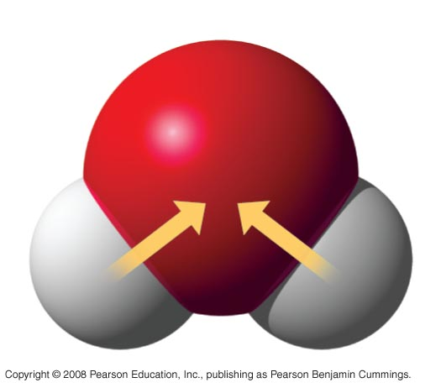
Fig. 2-13
δ –
O
H
H
δ+
δ+
H₂O
Notes:
Figure 2.13 Polar covalent bonds in a water molecule

Slide 37
Ionic Bonds
Atoms sometimes strip electrons from their bonding partners
An example is the transfer of an electron from sodium to chlorine
After the transfer of an electron, both atoms have charges
A charged atom (or molecule) is called an ion
Copyright © 2008 Pearson Education, Inc., publishing as Benjamin Cummings

Slide 38
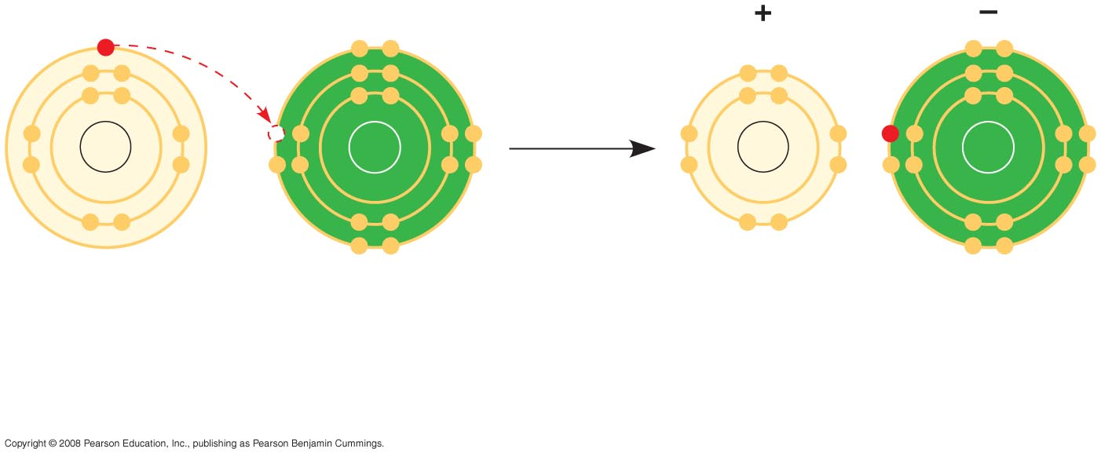
Fig. 2-14-2
Na
Cl
Na
Cl
Na
Cl
Na⁺
Cl–
Sodium atom
Chlorine atom
Sodium ion
(a cation)
Chloride ion
(an anion)
Sodium chloride (NaCl)
Notes:
Figure 2.14 Electron transfer and ionic bonding

Slide 39
A cation is a positively charged ion
An anion is a negatively charged ion
An ionic bond is an attraction between an anion and a cation
Animation: Ionic Bonds
Copyright © 2008 Pearson Education, Inc., publishing as Benjamin Cummings

Slide 40
Compounds formed by ionic bonds are called ionic compounds, or salts
Salts, such as sodium chloride (table salt), are often found in nature as crystals
Copyright © 2008 Pearson Education, Inc., publishing as Benjamin Cummings

Slide 41
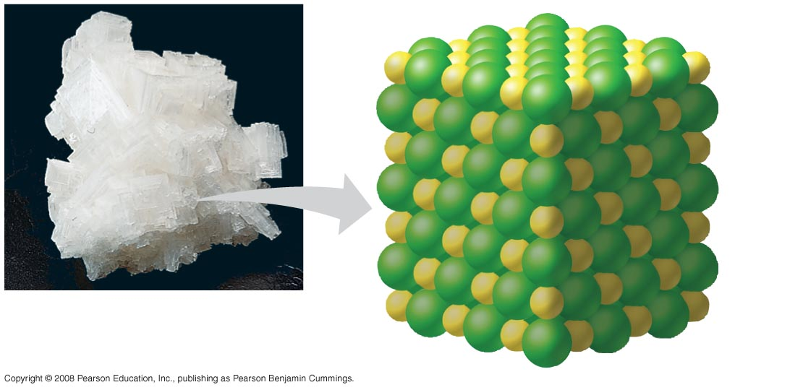
Fig. 2-15
Na⁺
Cl–
Notes:
Figure 2.15 A sodium chloride crystal

Slide 42
Weak Chemical Bonds
**Most of the strongest bonds in organisms are covalent bonds that form a cell’s molecules**
Weak chemical bonds, such as ionic bonds and hydrogen bonds, are also important
Weak chemical bonds reinforce shapes of large molecules and help molecules adhere to each other
Copyright © 2008 Pearson Education, Inc., publishing as Benjamin Cummings

Slide 43
Hydrogen Bonds
A hydrogen bond forms when a hydrogen atom covalently bonded to one electronegative atom is also attracted to another electronegative atom
In living cells, the electronegative partners are usually oxygen or nitrogen atoms
Copyright © 2008 Pearson Education, Inc., publishing as Benjamin Cummings

Slide 44
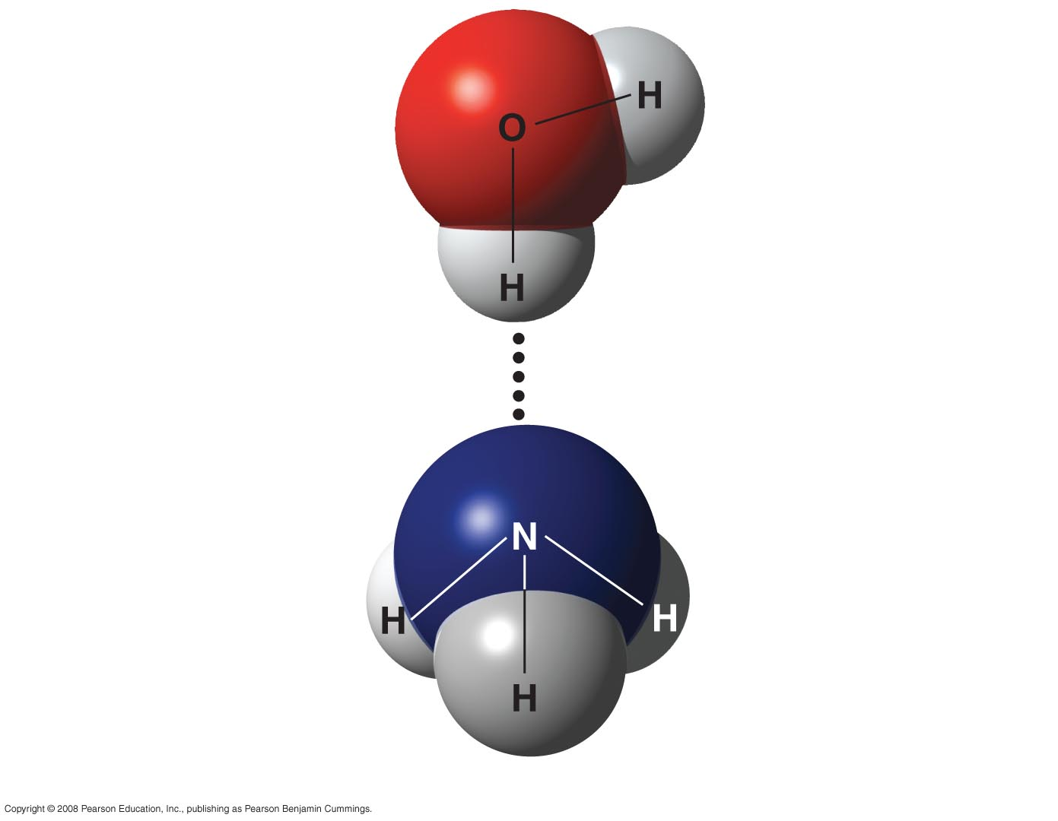
Fig. 2-16
δ −
δ+
Water (H₂O)
δ+
Hydrogen bond
δ −
Ammonia (NH₃)
δ+
δ+
δ+
Notes:
Figure 2.16 A hydrogen bond

Slide 45
Van der Waals Interactions
If electrons are distributed asymmetrically in molecules or atoms, they can result in “hot spots” of positive or negative charge
Van der Waals interactions are attractions between molecules that are close together as a result of these charges
Collectively, such interactions can be strong, as between molecules of a gecko’s toe hairs and a wall surface
Copyright © 2008 Pearson Education, Inc., publishing as Benjamin Cummings

Slide 46
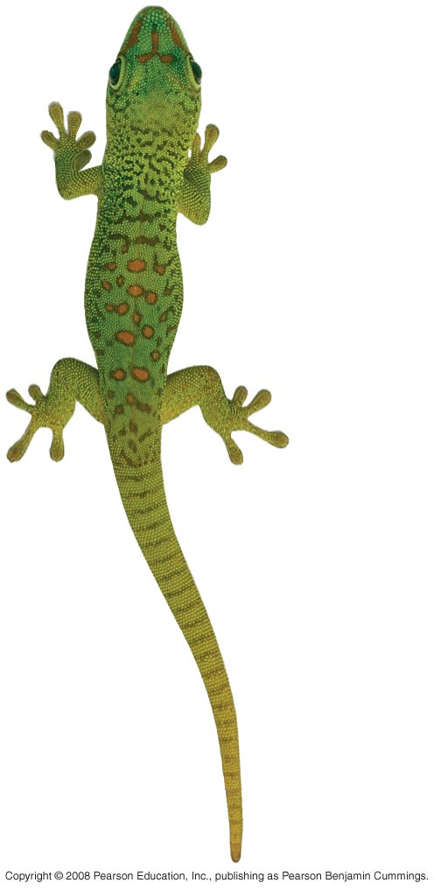
Fig. 2-UN1

Slide 47
Molecular Shape and Function
***A molecule’s shape is usually very important to its function****
A molecule’s shape is determined by the positions of its atoms’ valence orbitals
In a covalent bond, the s and p orbitals may hybridize, creating specific molecular shapes
Copyright © 2008 Pearson Education, Inc., publishing as Benjamin Cummings

Slide 48
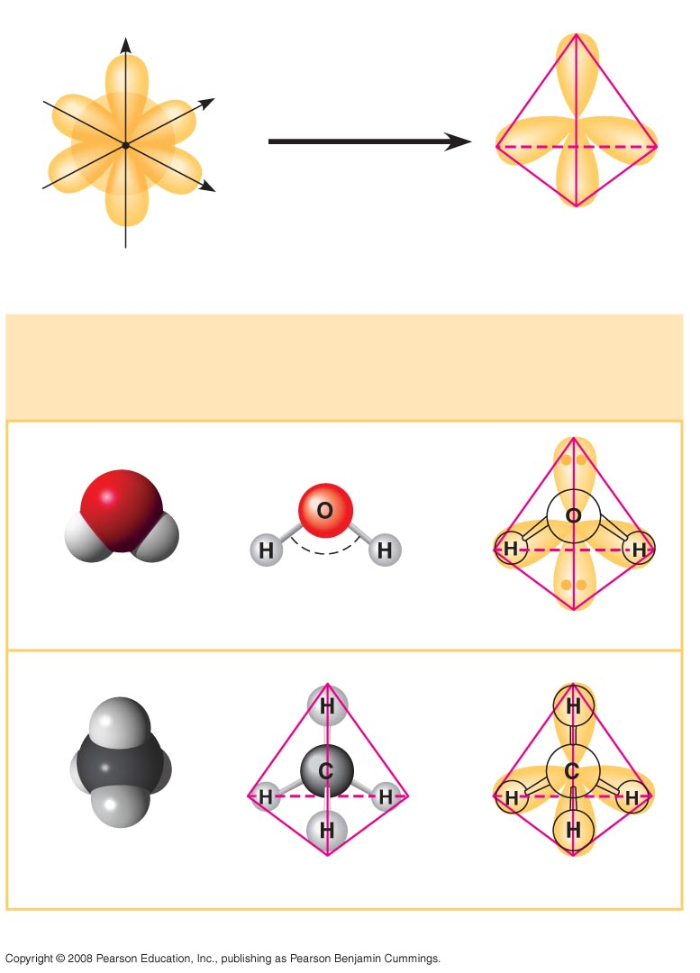
Fig. 2-17
z
Four hybrid orbitals
s orbital
Three p
orbitals
x
y
Tetrahedron
(a) Hybridization of orbitals
Space-filling
Model
Ball-and-stick
Model
Hybrid-orbital Model
(with ball-and-stick
model superimposed)
Unbonded
electron
pair
104.5º
Water (H₂O)
Methane (CH₄)
(b) Molecular-shape models
Notes:
Figure 2.17 Molecular shapes due to hybrid orbitals

Slide 49
Biological molecules recognize and interact with each other with a specificity based on molecular shape
Molecules with similar shapes can have similar biological effects
Copyright © 2008 Pearson Education, Inc., publishing as Benjamin Cummings

Slide 50
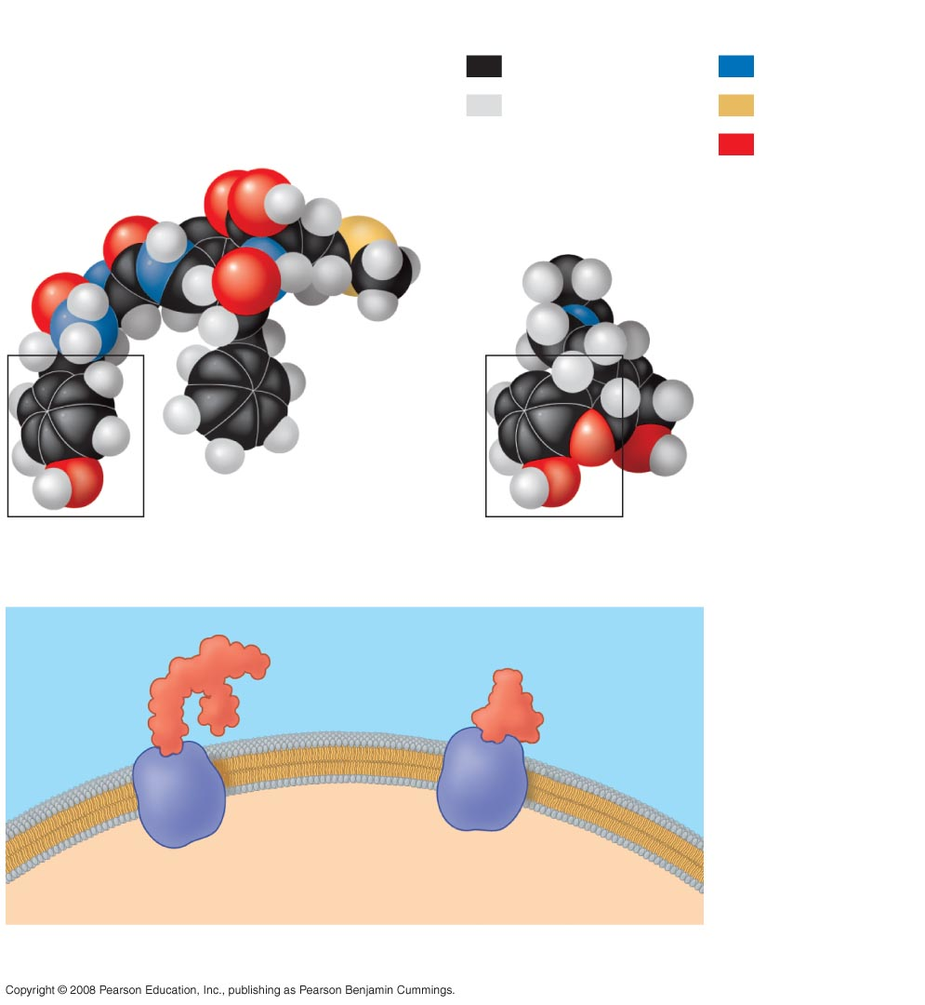
Fig. 2-18
Key
Carbon
Nitrogen
Hydrogen
Sulfur
Natural endorphin
Oxygen
Morphine
(a) Structures of endorphin and morphine
Natural
endorphin
Morphine
Endorphin
receptors
Brain cell
(b) Binding to endorphin receptors
Notes:
Figure 2.18 A molecular mimic

Slide 51
Concept 2.4: Chemical reactions make and break chemical bonds
Chemical reactions are the making and breaking of chemical bonds
The starting molecules of a chemical reaction are called reactants
The final molecules of a chemical reaction are called products
Copyright © 2008 Pearson Education, Inc., publishing as Benjamin Cummings

Slide 52
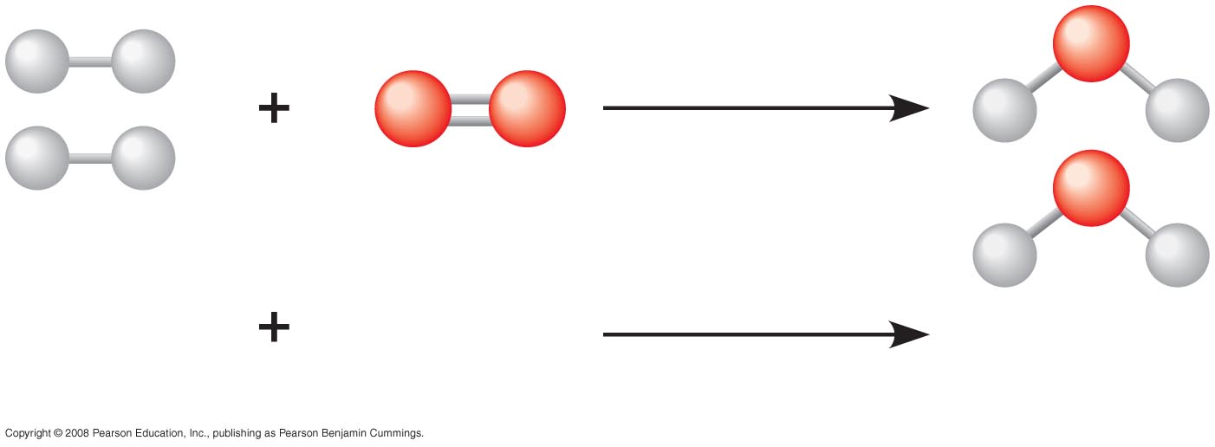
Fig. 2-UN2
2 H₂
O₂
2 H₂O
Reactants
Reaction
Products

Slide 53
Photosynthesis is an important chemical reaction
Sunlight powers the conversion of carbon dioxide and water to glucose and oxygen
6 CO₂ + 6 H₂0 → C₆H₁₂O₆ + 6 O₂
Copyright © 2008 Pearson Education, Inc., publishing as Benjamin Cummings

Slide 54
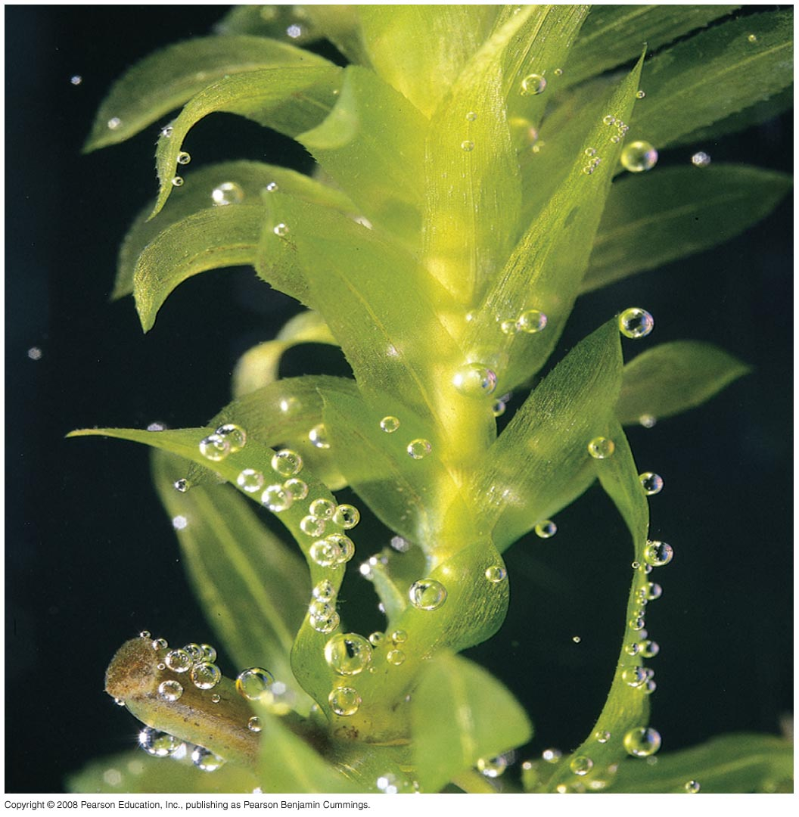
Fig. 2-19
Notes:
Figure 2.19 Photosynthesis: a solar-powered rearrangement of matter

Slide 55
Some chemical reactions go to completion: all reactants are converted to products
All chemical reactions are reversible: products of the forward reaction become reactants for the reverse reaction
Chemical equilibrium is reached when the forward and reverse reaction rates are equal
Copyright © 2008 Pearson Education, Inc., publishing as Benjamin Cummings

Slide 56
Fig. 2-UN3
Nucleus
Protons (+ charge)
determine element
Electrons (– charge) form negative cloud
and determine
chemical behavior
Neutrons (no charge)
determine isotope
Atom

Slide 57
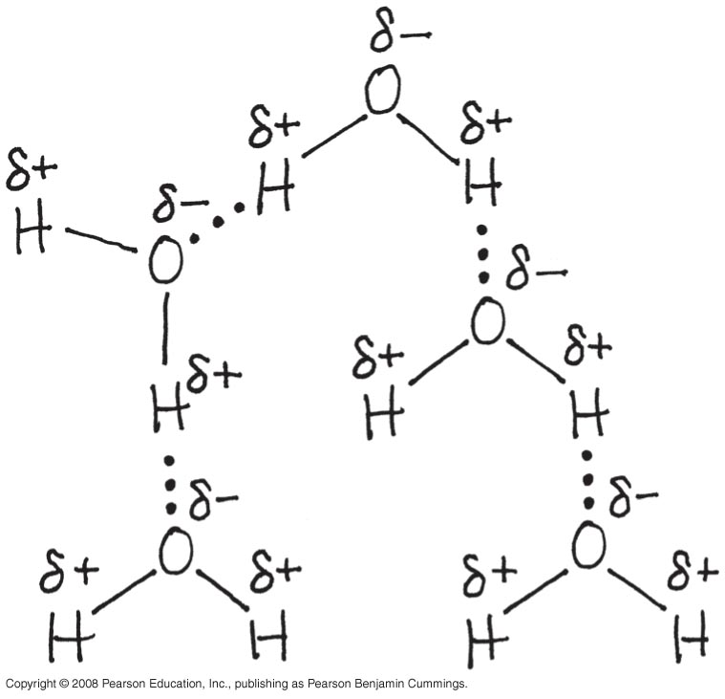
Fig. 2-UN9

Slide 58
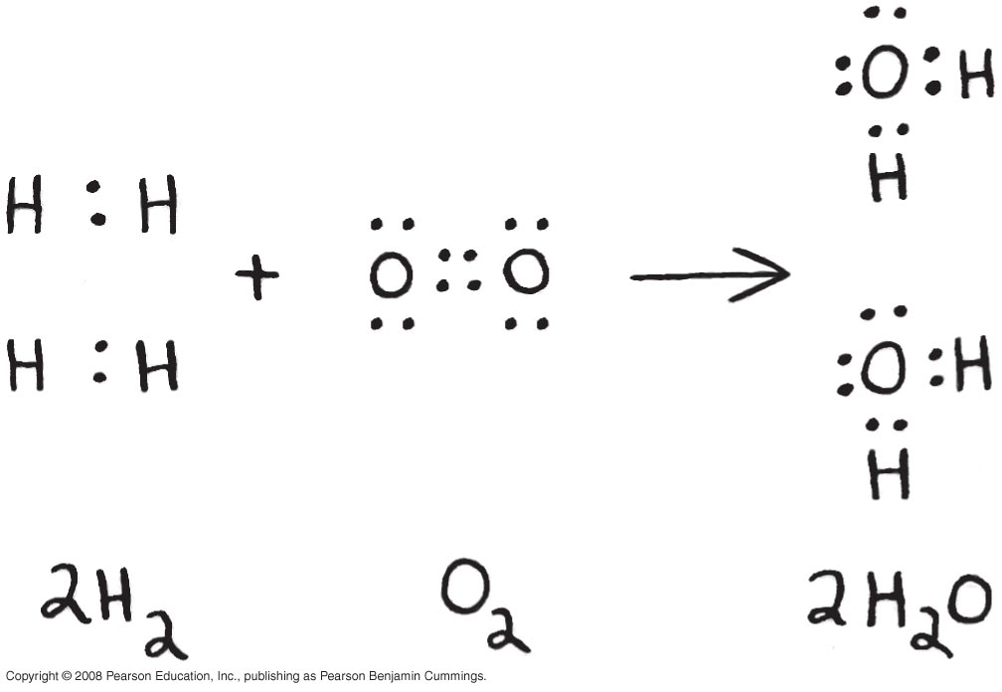
Fig. 2-UN10

Slide 59
Fig. 2-UN11

Slide 60
You should now be able to:
Identify the four major elements
Distinguish between the following pairs of terms: neutron and proton, atomic number and mass number, atomic weight and mass number
Distinguish between and discuss the biological importance of the following: nonpolar covalent bonds, polar covalent bonds, ionic bonds, hydrogen bonds, and van der Waals interactions
Copyright © 2008 Pearson Education, Inc., publishing as Benjamin Cummings

